Slide 1

Data Programming Presentation
Group 7 Nov 4, 2021

Slide 2
TABLE OF CONTENTS
01
ABOUT US
02
Introduction
03
Features
Flowchart
Demo
KPI OVERVIEW
04
05
06
Introduction of our team
Introduction to the application
The application features and each importance
Resources
The importance flowchart
Demonstration of the application
References and GitHub

Slide 3
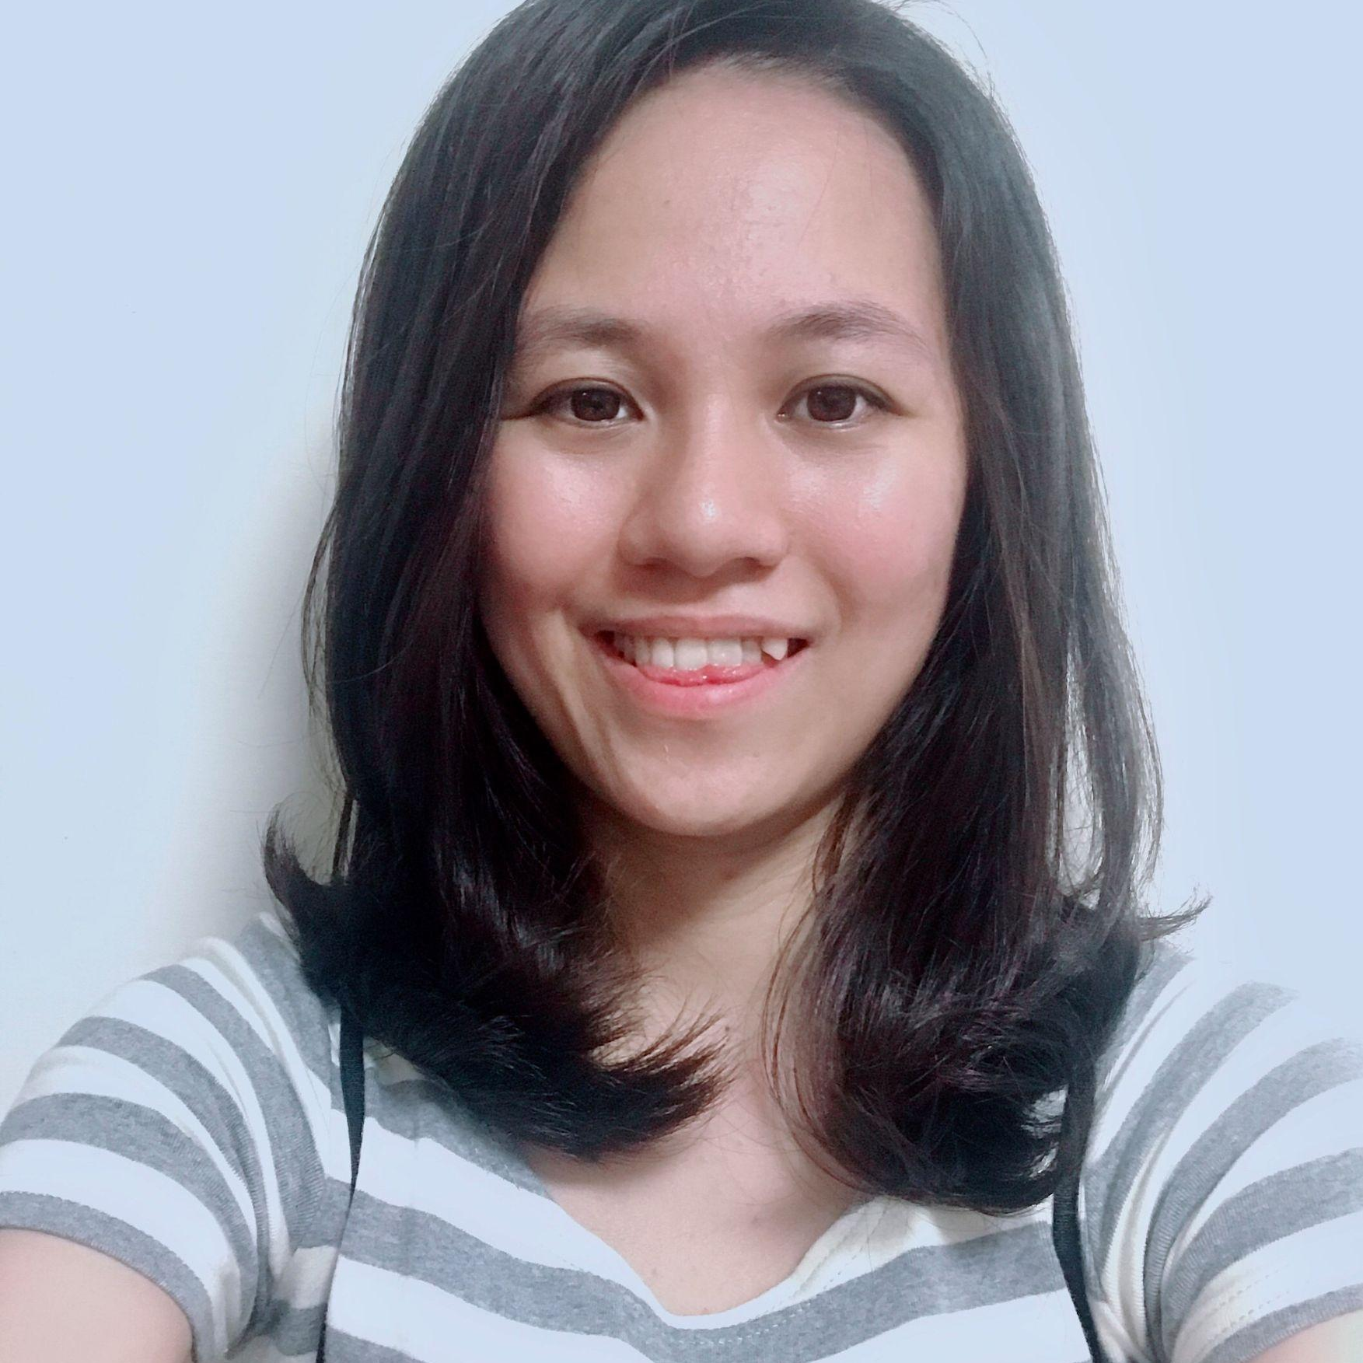

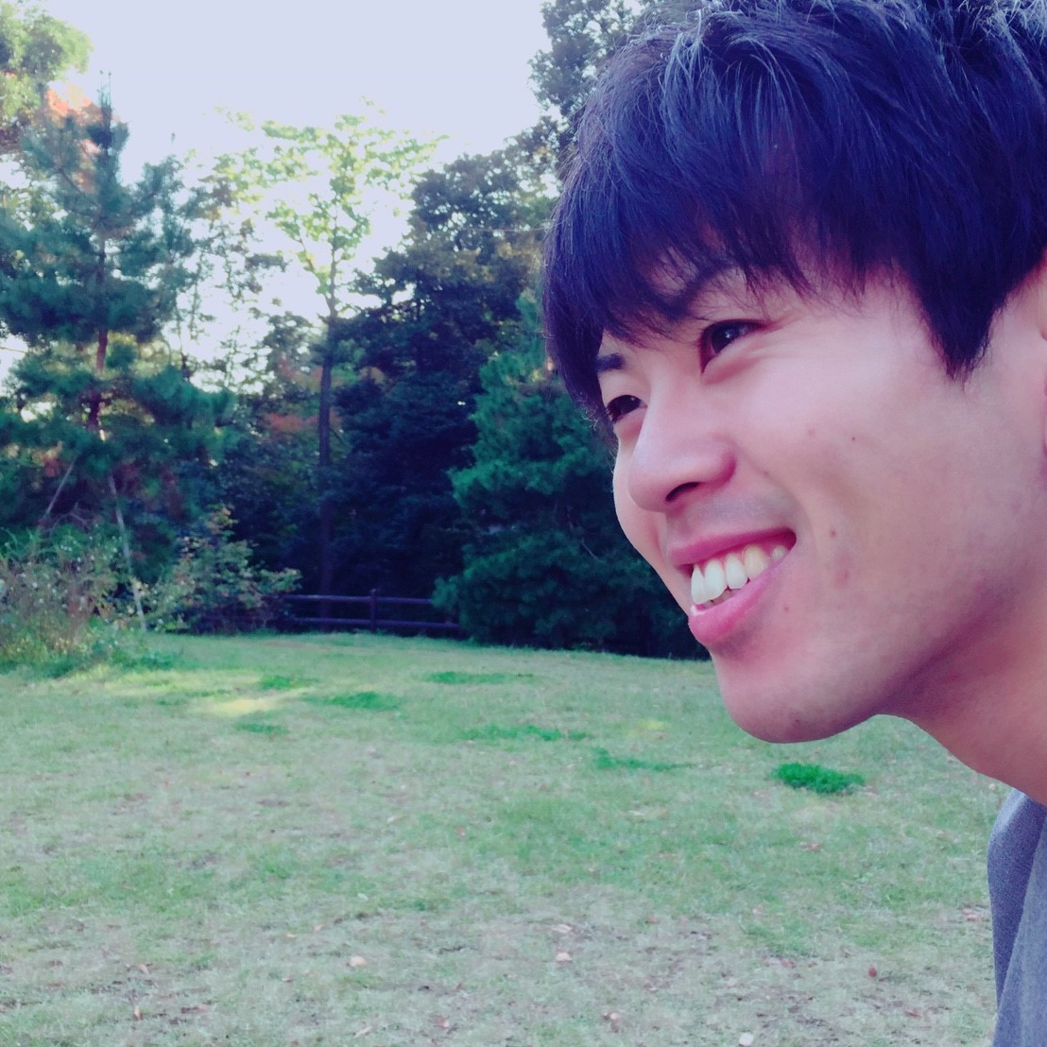
OUR TEAM
Vivianne
Ashwin
Kazuhiro Onishi

Slide 4
Introduction
- This application has an interface
- Student data is saved and stored in database
- Student data can be searched by SQL
- Student data can be updated

Slide 5
Design for Application
Login
Select Status
Search
Create
Replace
Delete
Login the student portal
Select student, admin or faculty
Search your information
Create new information
Replace your exsiting information
Delete your information

Slide 6
Primary Features
Student ID
Course/ Program
Name
Semester
Email Address
Nationality
Birth
Location

Slide 7
Other Features
-Degree/Other Certificates
-Public Speaking /Presentations (Yes/No) and Level
-Programming Experience (Yes/No)
-Business Intelligence/Reporting Experience - tools (Yes/No) and Level
-Experience with Excel (Yes/No) and Level
-Special Interests
-Favorite Food

Slide 8
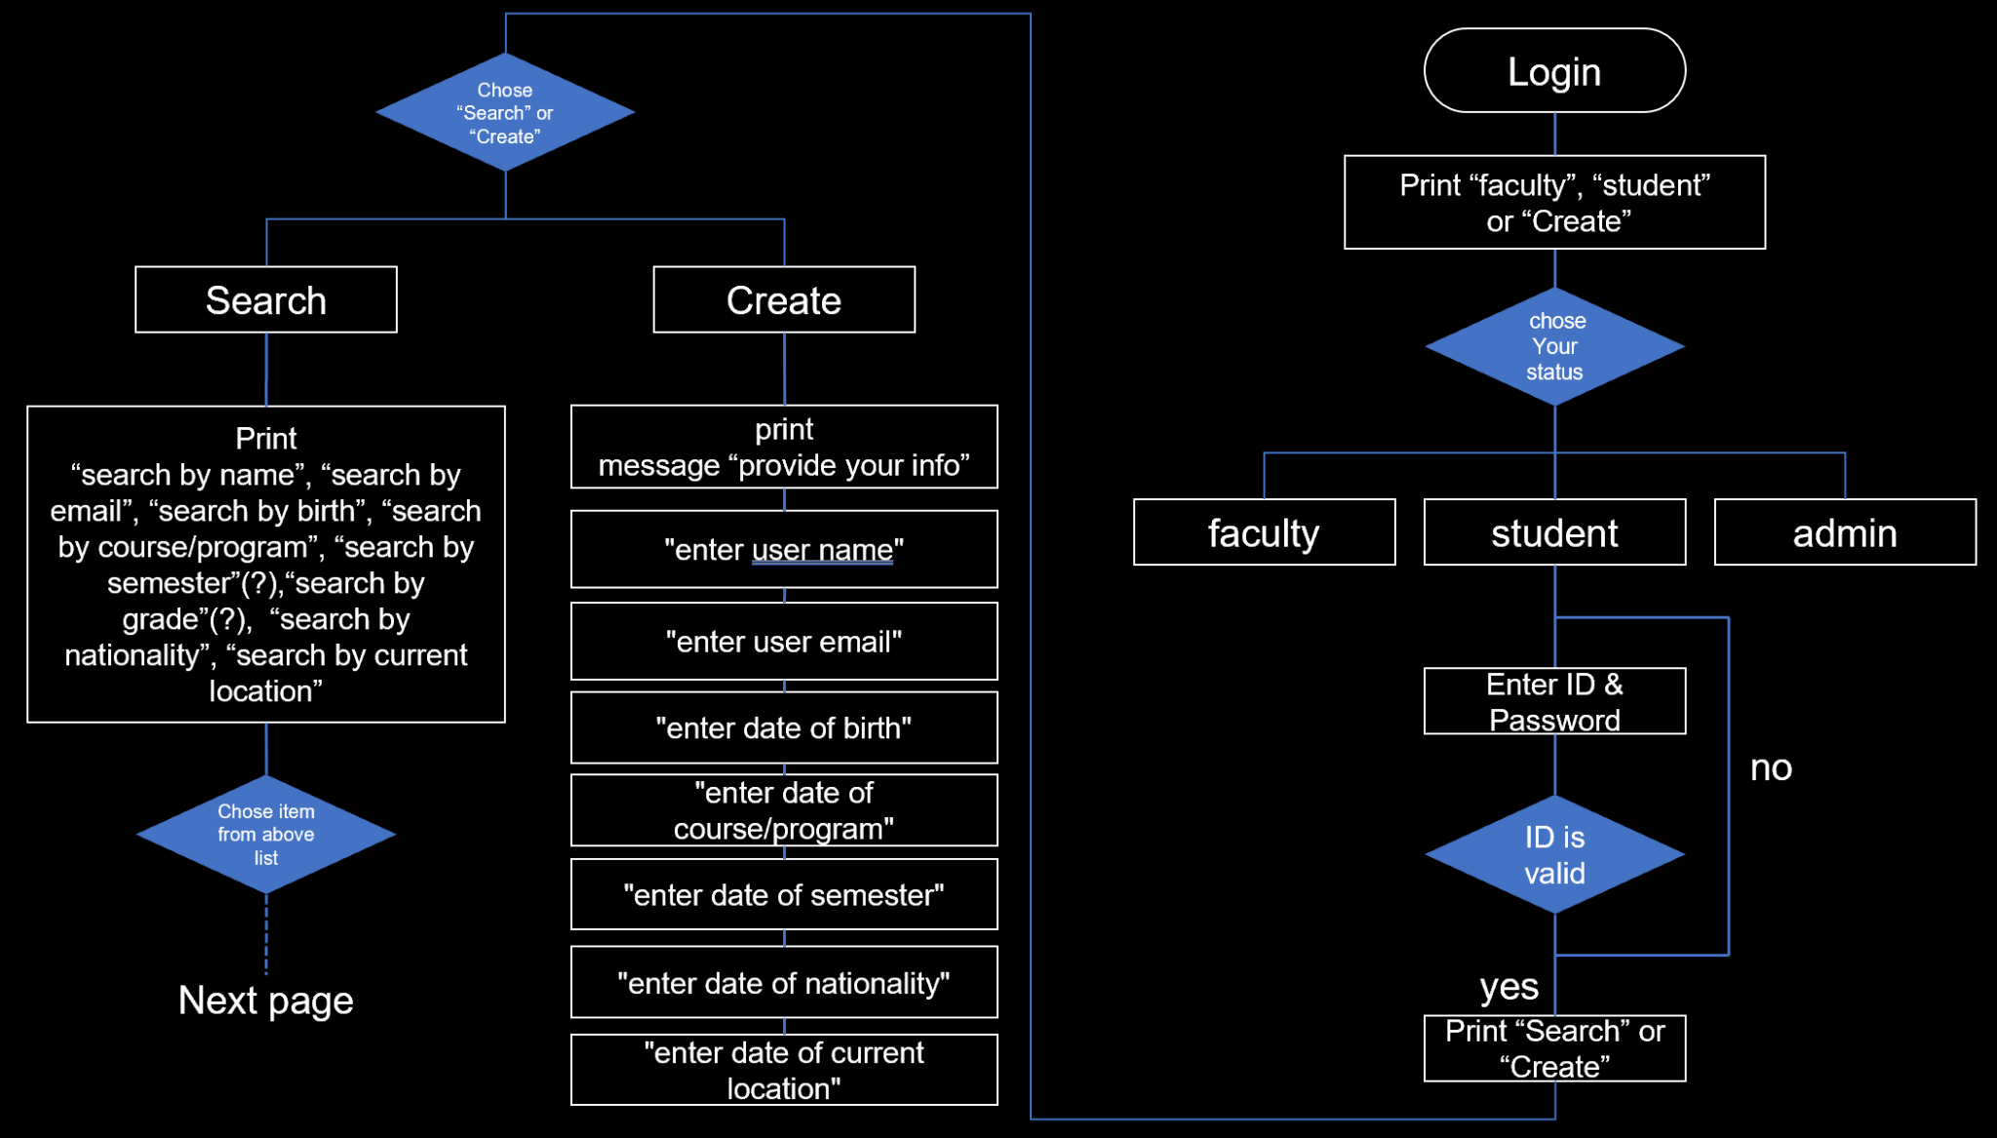
Flow chart

Slide 9
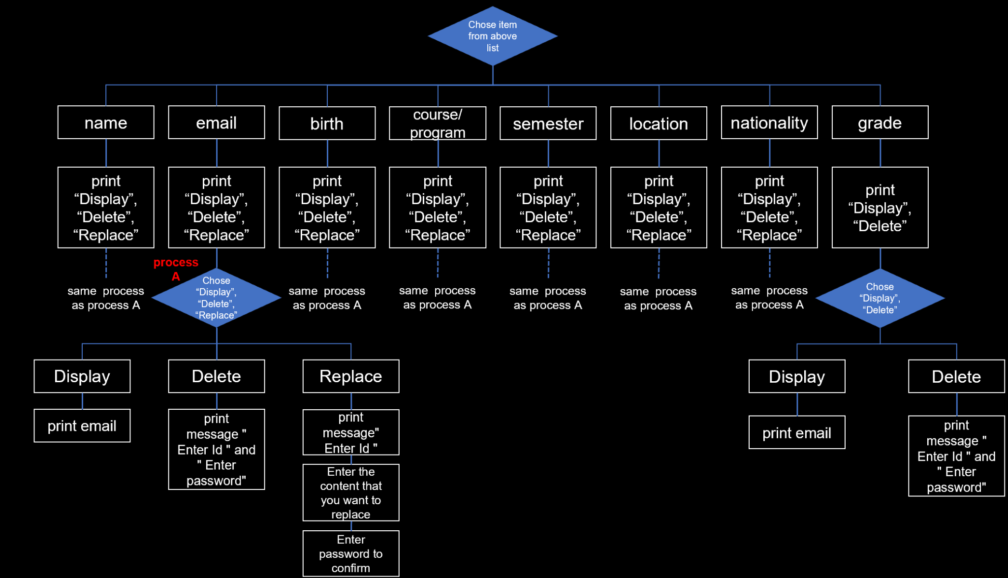
Flow chart

Slide 10
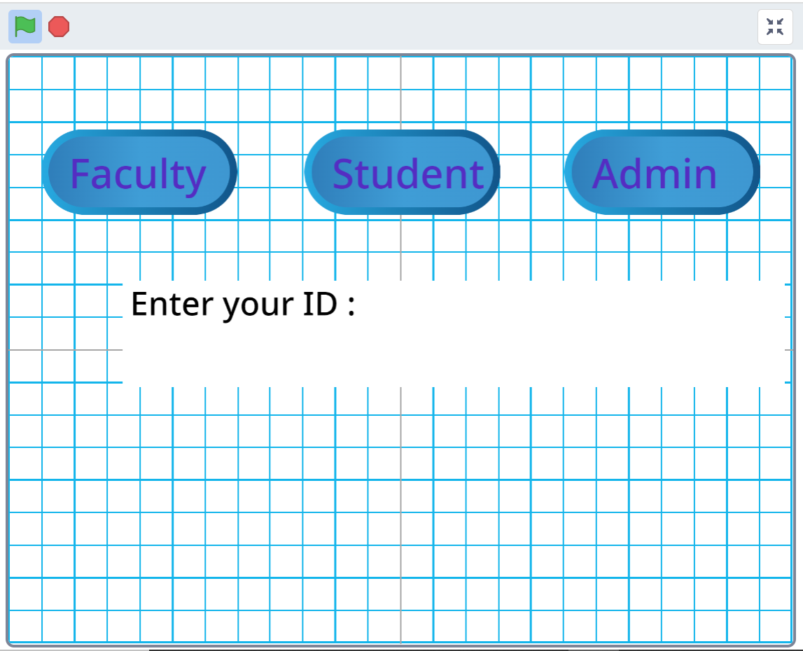
Prototype

Slide 11
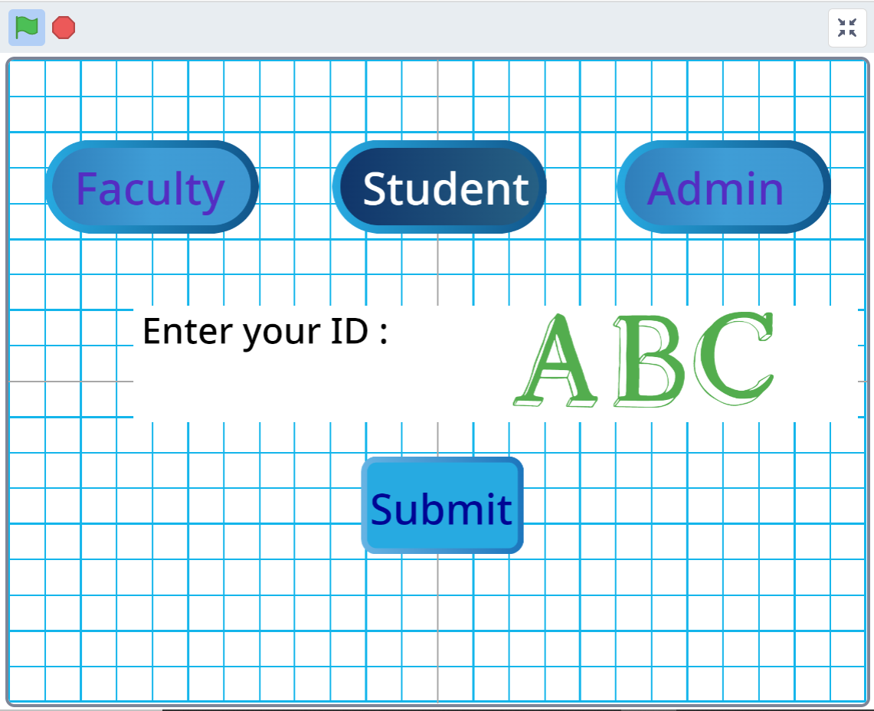
Prototype

Slide 12
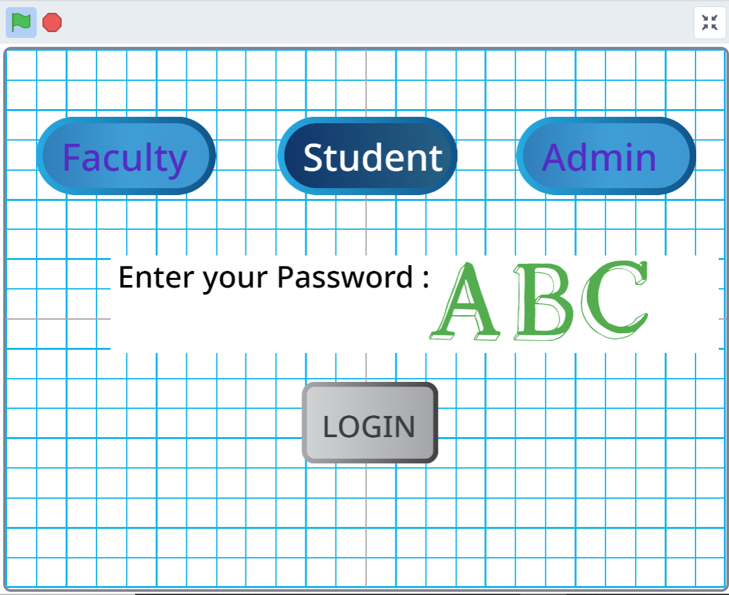
Prototype

Slide 13
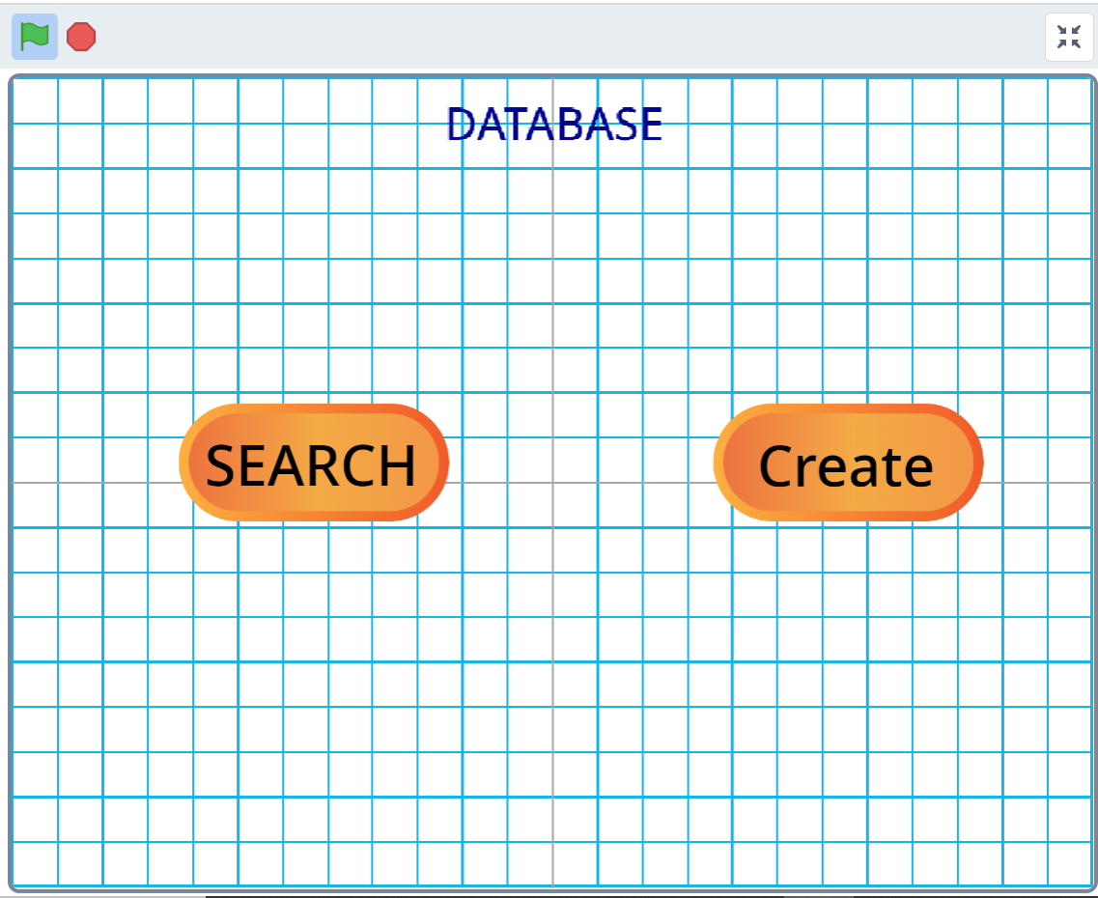
Prototype

Slide 14
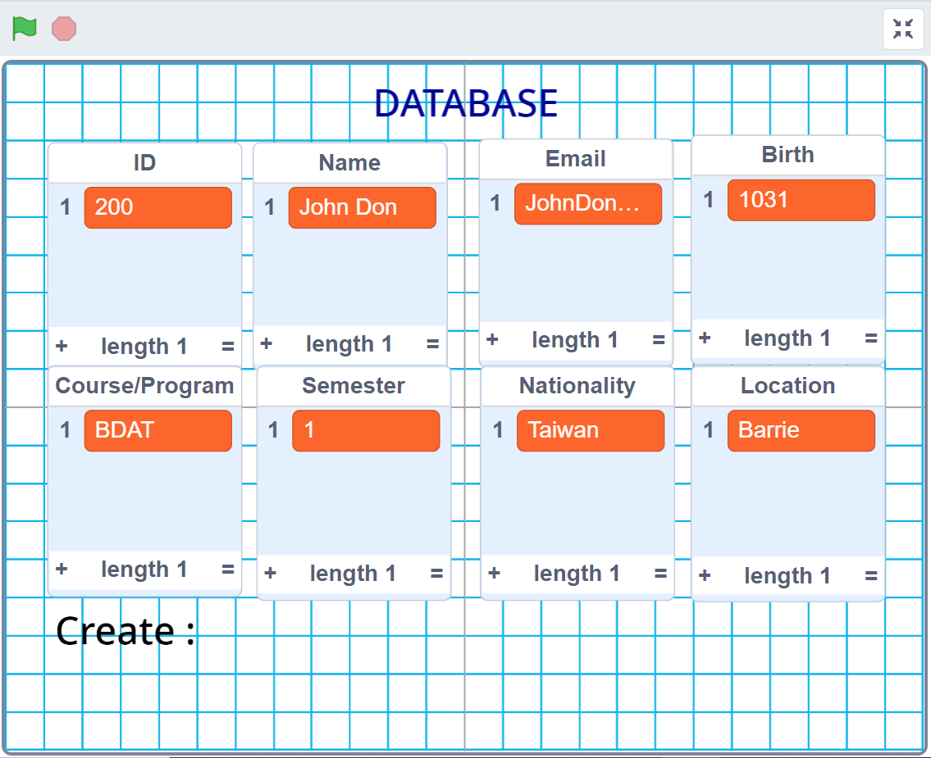
Prototype

Slide 15
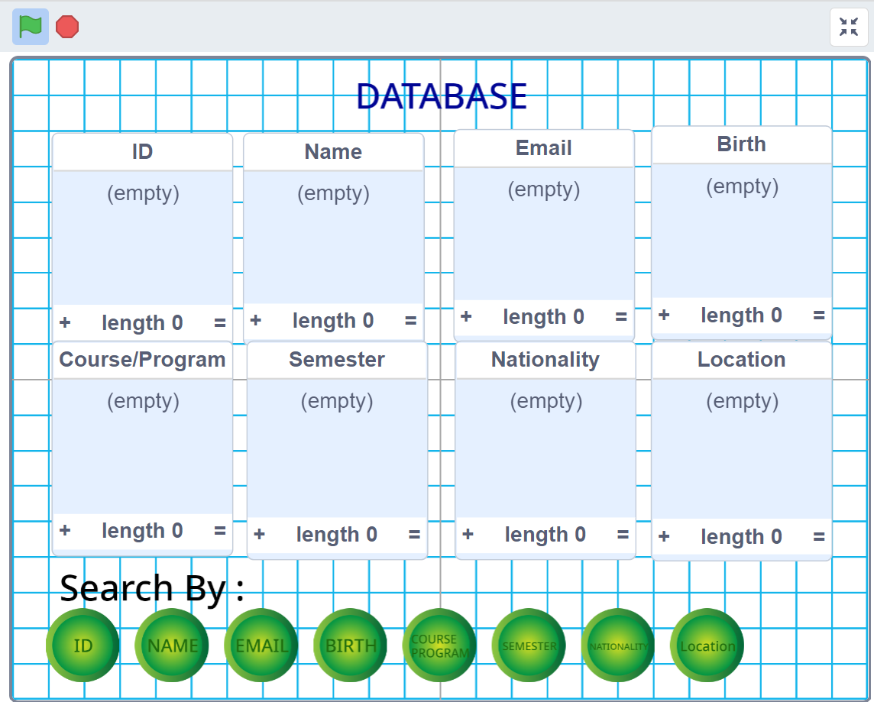
Prototype

Slide 16
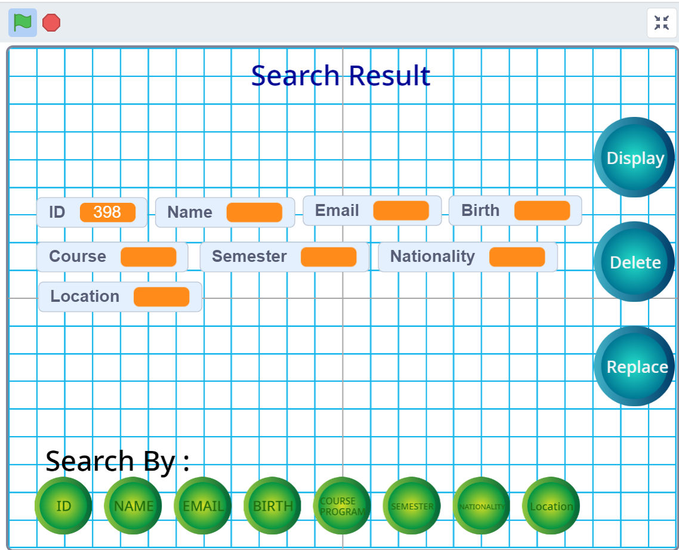
Prototype

Slide 17
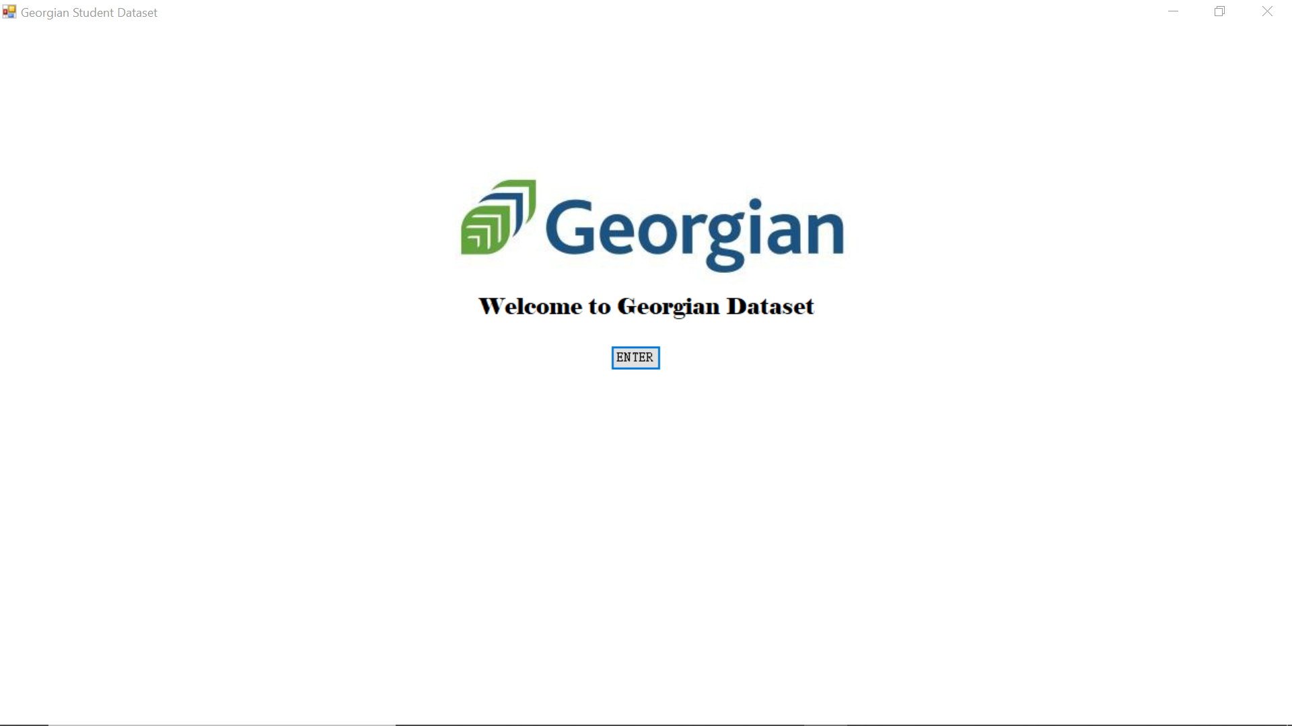
Demonstration

Slide 18
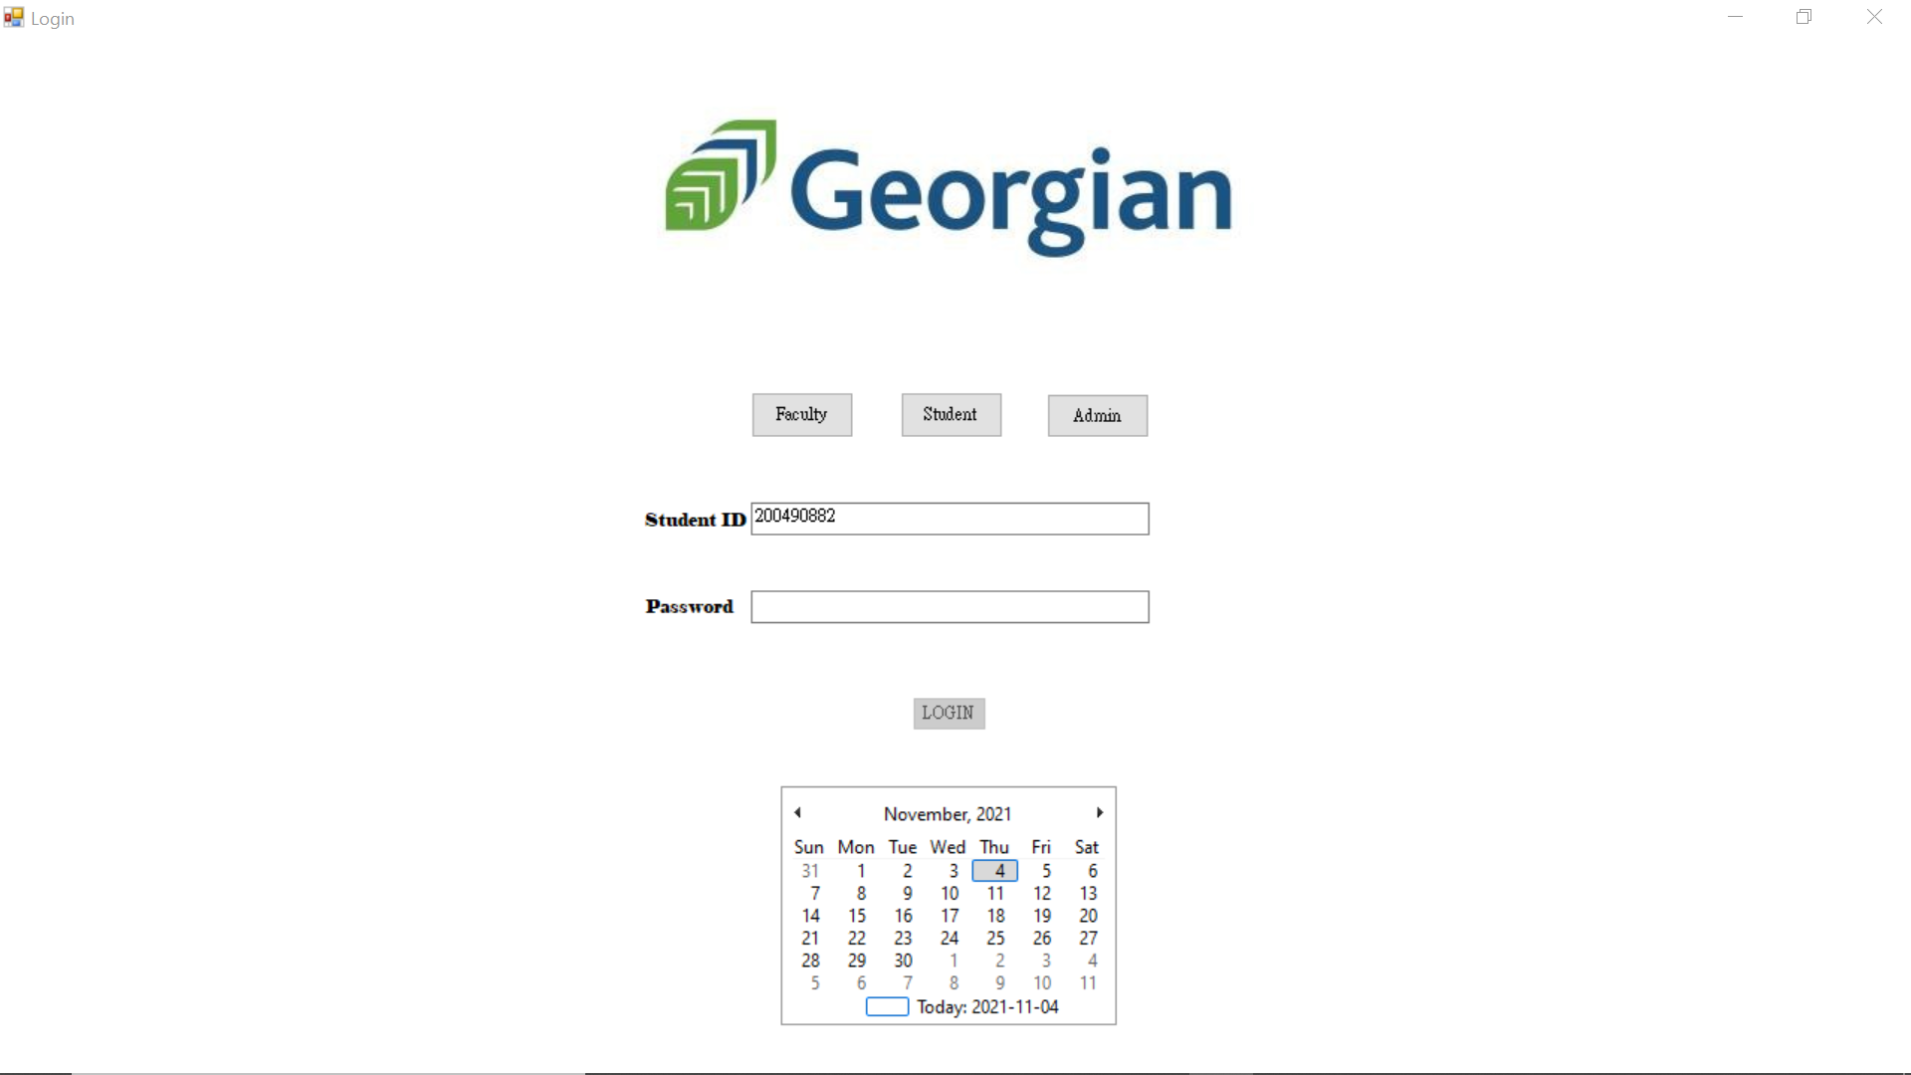
Demonstration

Slide 19
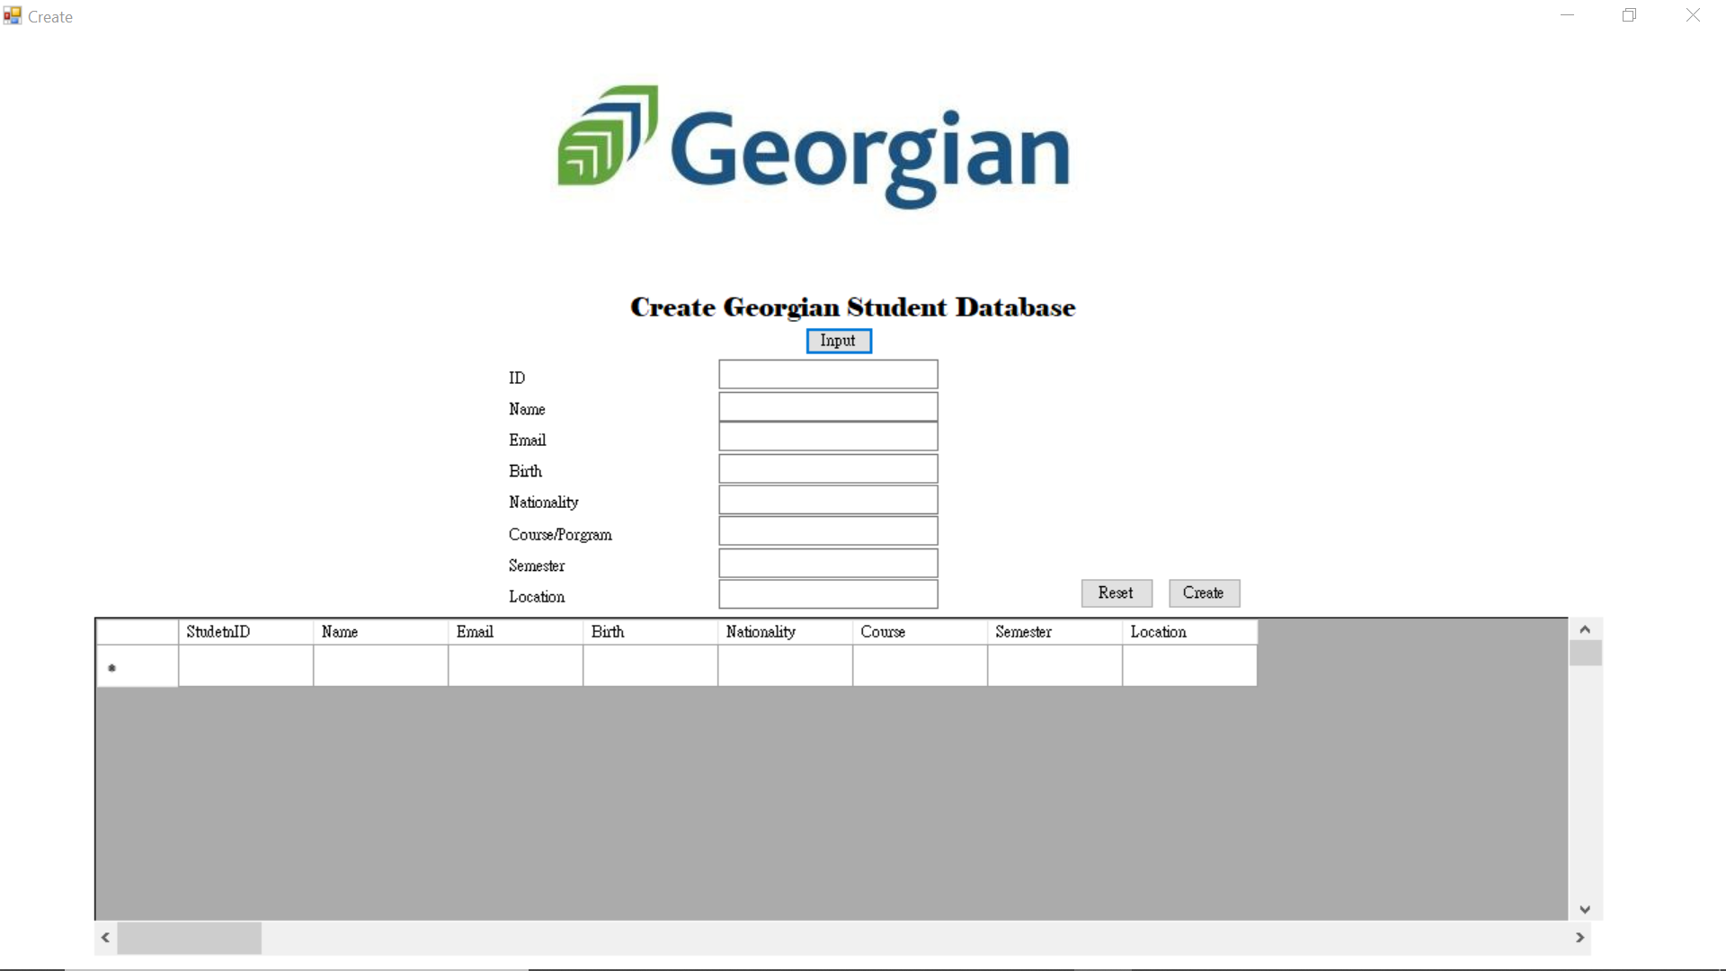
Demonstration

Slide 20
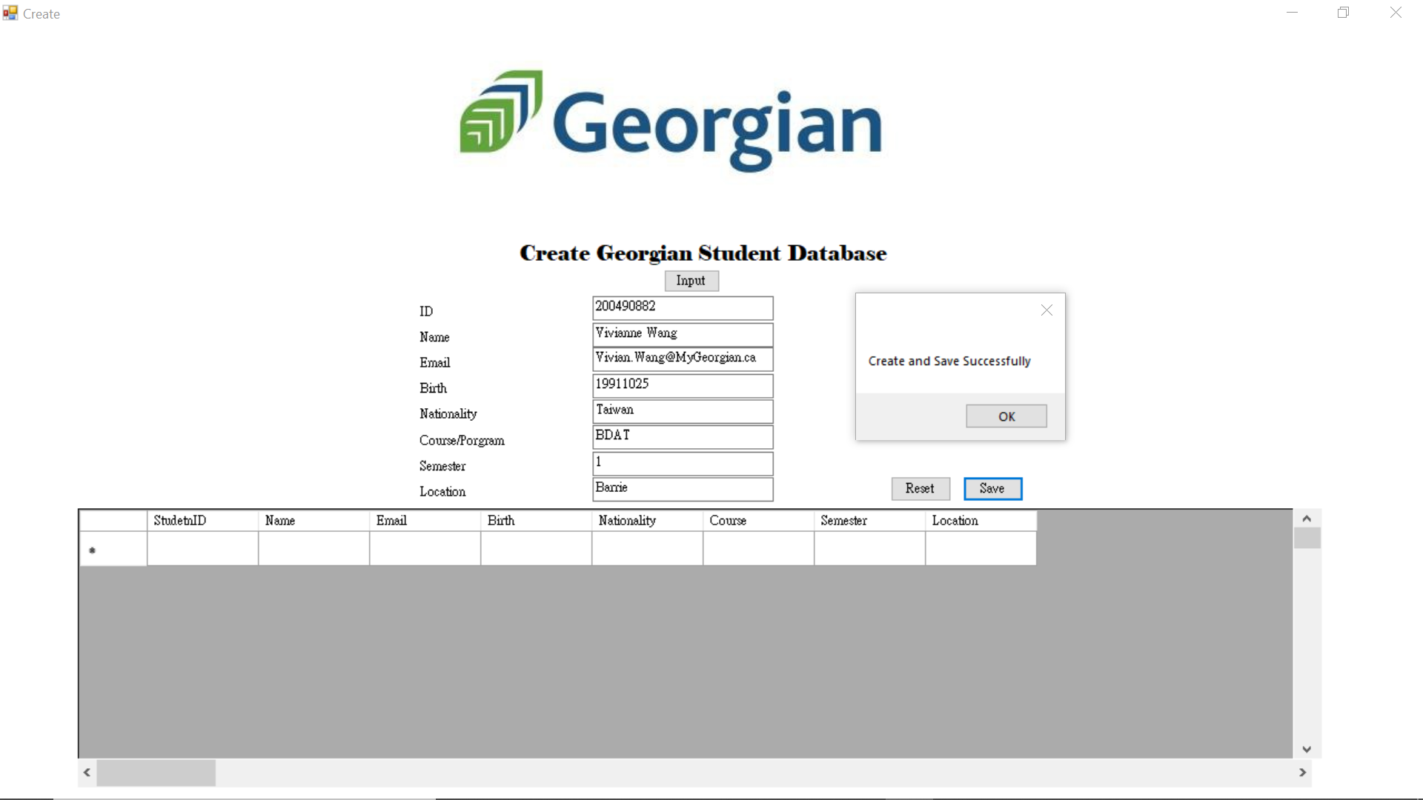
Demonstration

Slide 21
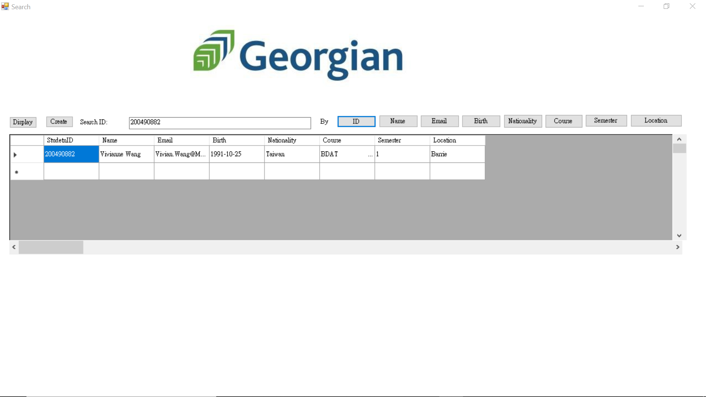
Demonstration

Slide 22
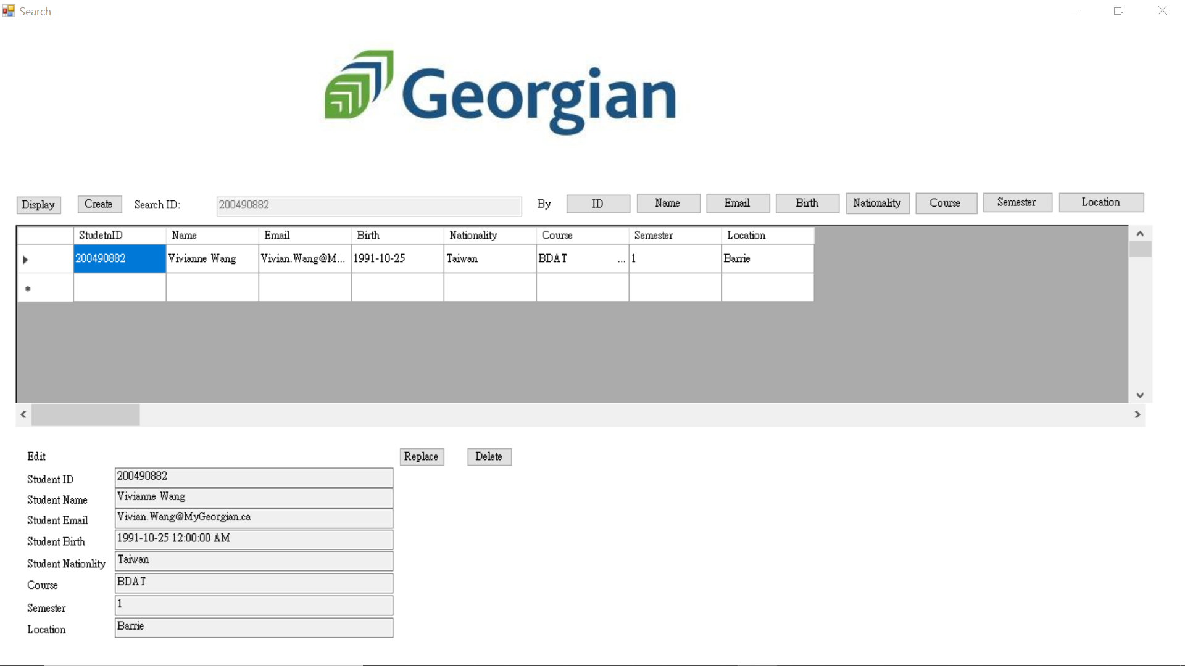
Demonstration

Slide 23
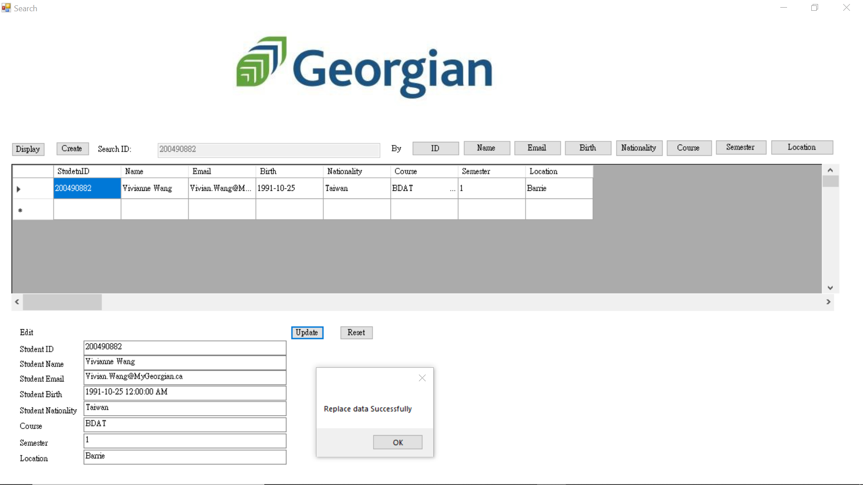
Demonstration

Slide 24
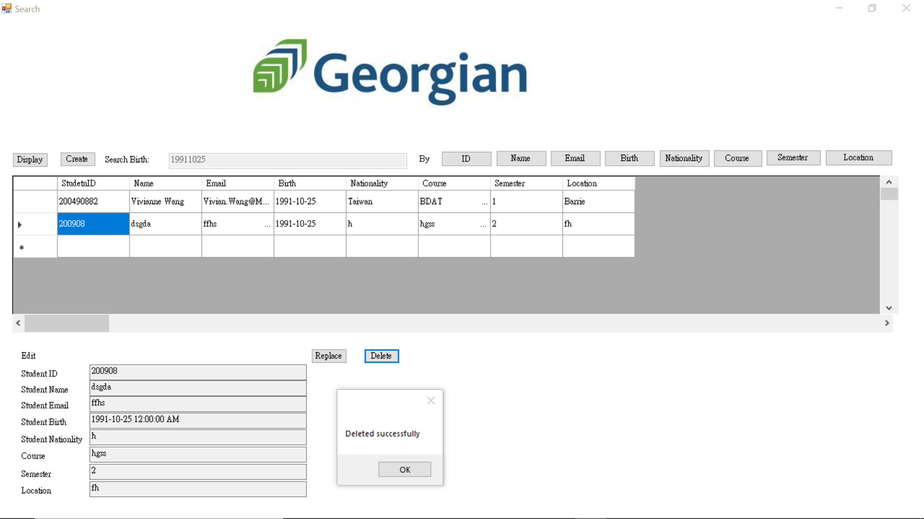
Demonstration

Slide 25
RESOURCES
GitHub:
https://github.com/YuTsengWang/Vivianne_Wang.git
References:
https://www.youtube.com/watch?v=-2UcDV4uUu8
https://www.c-sharpcorner.com/UploadFile/718fc8/save-delete-search-and-update-record-in-ado-net/
https://medium.com/singapore-rails-learning-group/how-to-push-your-code-to-github-and-publish-your-first-page-8b0e1f4caf2a
Prototype: (made by Vivianne) https://scratch.mit.edu/projects/564715919/fullscreen/

Slide 26
THANK YOU
THANKS!
Q & A
if (textBox1.Text !="") {
Info
Data Programming
BDAT 1004-21F-10885
Vivian Wang (Yu Tseng Wang)
200490882
Vivian.Wang@MyGeorgian.ca

